Slide 1

Web Development & Design Foundations with HTML5
Tenth Edition
Chapter 8
Tables
Copyright © 2021, 2019, 2017 Pearson Education, Inc. All Rights Reserved

Slide 2
Learning Outcomes
In this chapter, you will learn how to ...
Create a basic table with the table, table row, table header, and table cell elements
Configure table sections with the thead, tbody, and tfoot elements
Increase the accessibility of a table
Style an HTML table with CSS
Describe the purpose of CSS structural pseudo-classes

Slide 3
HTML Table
Tables are used on web pages to organize tabular information
Composed of rows and columns – similar to a spreadsheet.
Each individual table cell is at the intersection of a specific row and column.
Configured with table, tr, and td elements

Slide 4
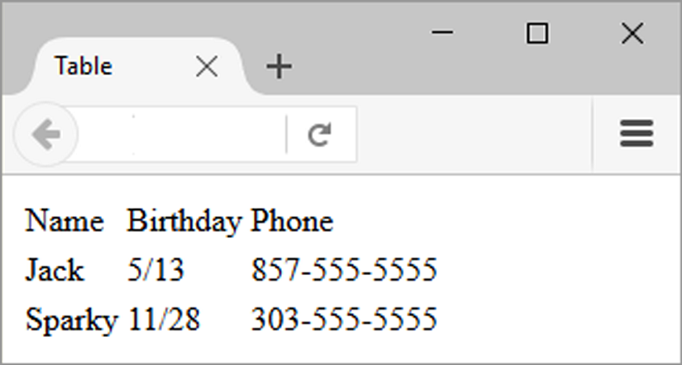
Figure 8.1 Table with three rows and three columns

Slide 5
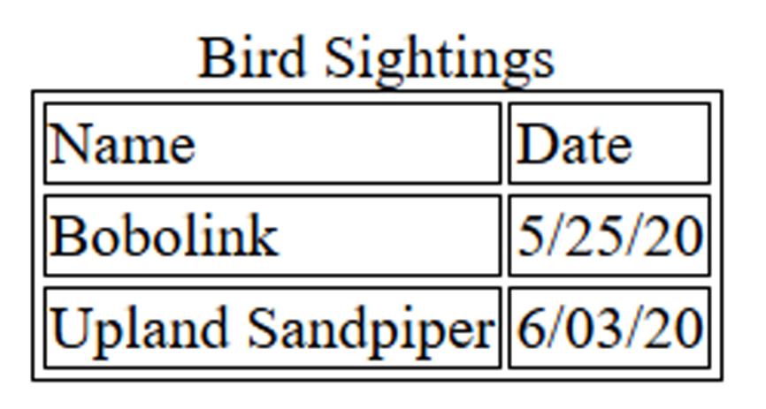
HTML Table Elements
<table> Contains the table
<tr> Contains a table row
<td> Contains a table cell
<caption> Configures a description of the table
Figure 8.2 The caption for this table is “Bird Sightings”

Slide 6
HTML Table Example (1 of 2)
<table> <caption>Bird Sightings</caption>
<tr>
<td>Name</td>
<td>Date</td>
</tr>
<tr>
<td>Bobolink</td>
<td>5/25/20</td>
</tr>

Slide 7
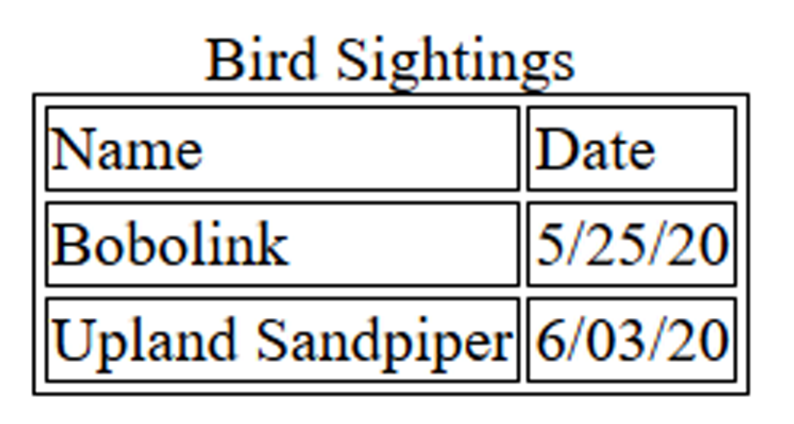
HTML Table Example (2 of 2)
<tr>
<td>Upland Sandpiper</td>
<td>6/03/20</td>
</tr>
</table>
Figure 8.2 The caption for this table is “Bird Sightings”

Slide 8
Table Borders
Obsolete Method: HTML border attribute
Modern Method: CSS border Property
table, td, th { border: 1px solid #000; }
Figure 8.2 The caption for this table is “Bird Sightings”

Slide 9
HTML Table Example 2 (1 of 2)
<table>
<tr>
<th>Name</th>
<th>Birthday</th>
</tr>
<tr>
<td>James</td>
<td>11/08</td>
</tr>

Slide 10
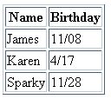
HTML Table Example 2 (2 of 2)
<tr>
<td>Karen</td>
<td>4/17</td>
</tr>
<tr>
<td>Sparky</td>
<td>11/28</td>
</tr>
</table>
Using the <th> Element

Slide 11
HTML Table Attributes
align (obsolete)
bgcolor (obsolete)
border (obsolete)
cellpadding (obsolete)
cellspacing (obsolete)
summary (obsolete)
width (obsolete)
Use CSS to configure table characteristics instead of HTML attributes

Slide 12
HTML Common Table Cell Attributes
align (obsolete)
bgcolor (obsolete)
colspan
rowspan
valign (obsolete)
height (deprecated)
width (deprecated)
Use CSS to configure most table cell characteristics instead of HTML attributes

Slide 13
HTML colspan Attribute (1 of 2)
<table>
<tr>
<td colspan=“2”> Birthday List</td>
</tr>
<tr>
<td>James</td>
<td>11/08</td>
</tr>

Slide 14

HTML colspan Attribute (2 of 2)
<tr>
<td>Karen</td>
<td>4/17</td>
</tr>
</table>

Slide 15
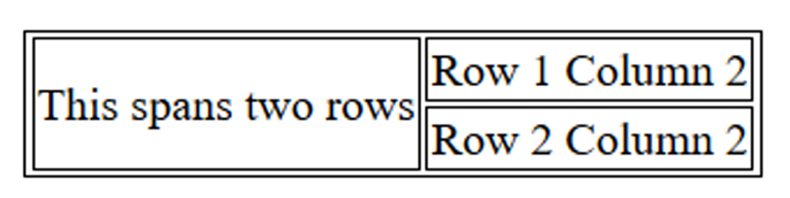
HTML rowspan Attribute
<table>
<tr>
<td rowspan="2">This spans two rows</td>
<td>Row 1 Column 2</td>
</tr>
<tr>
<td>Row 2 Column 2</td>
</tr>
</table>
Figure 8.6 Table with a column that spans
two rows

Slide 16
Accessibility and Tables (1 of 3)
Use table header elements (<th> tags) to indicate column or row headings.
Use the caption element to provide a text title or caption for the table.
Complex tables: Associate table cell values with their corresponding headers
<th> tag id attribute
<td> tag headers attribute

Slide 17
Accessibility and Tables (2 of 3)
<table>
<caption>Bird Sightings</caption>
<tr>
<th id="name">Name</th>
<th id="date">Date</th>
</tr>
<tr>
<td headers="name">Bobolink</td>
<td headers="date">5/25/20</td>
</tr>

Slide 18
Accessibility and Tables (3 of 3)
<tr>
<td headers="name">Upland Sandpiper</td>
<td headers="date">6/03/20</td>
</tr>
</table>
Figure 8.8 This simple data table uses <th> tags and the caption element to provide accessibility

Slide 19
Checkpoint (1 of 2)
Describe the purpose of using a table on a web page.
How is the text contained in a th element displayed by the browser?
Describe one coding technique that increases the accessibility of an HTML table.

Slide 20
Using CSS to Style a Table
HTML Attribute | CSS Property
align | Center align a table: table { width: 75%; margin: auto; } Center align within a table cell: text-align: center;
bgcolor | background-color
cellpadding | padding
cellspacing | border-spacing or border-collapse
height | height
valign | vertical-align
width | width
border | border, border-style, or border-spacing
-- | background-image
Excerpted from Table 8.4

Slide 21
CSS Structural Pseudo-classes
Table 8.5 Common CSS structural pseudo-classes
Pseudo-class | Purpose
:first-of-type | Applies to the first element of the specified type
:first-child | Applies to the first child of an element (CSS2 selector)
:last-of-type | Applies to the last element of the specified type
:last-child | Applies to the last child of an element
:nth-of-type(n) | Applies to the “nth” element of the specified type Values: a number, odd, or even
Zebra Stripe a Table tr:nth-of-type(even) { background-color: #eaeaea; }

Slide 22
Table Row Groups (1 of 3)
<table> <caption>Time Sheet</caption>
<thead>
<tr>
<th id="day">Day</th>
<th id="hours">Hours</th>
</tr>
</thead>

Slide 23
Table Row Groups (2 of 3)
<tbody>
<tr>
<td headers="day">Monday</td>
<td headers="hours">4</td>
</tr>
…
<tr>
<td headers="day">Friday</td>
<td headers="hours">3</td>
</tr>

Slide 24
Table Row Groups (3 of 3)
<thead> table head rows
<tbody> table body rows
<tfoot> table footer rows
</tbody>
<tfoot>
<tr>
<td headers="day">Total</td>
<td headers="hours">18</td>
</tr>
</tfoot> </table>

Slide 25
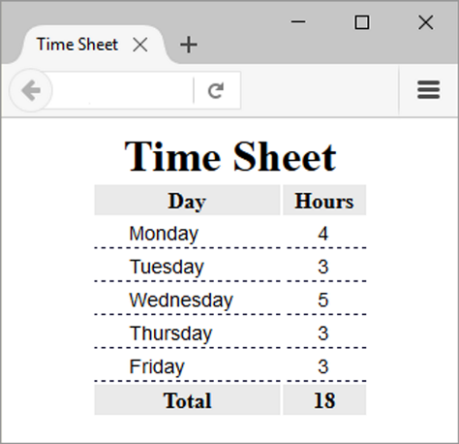
Figure 8.12 CSS configures the thead, tbody, and tfoot element selectors

Slide 26
Checkpoint (2 of 2)
Describe a reason to configure a table with CSS properties instead of HTML attributes.
List three elements that are used to group table rows.

Slide 27
Summary
This chapter introduced the HTML and CSS techniques used to create and configure tables on web pages.

